Slide 1
CS736 - Assignment-2
Team Members
Atharv Shingewar (24M0834)
Russel Abreo (24M2107)
Under the Guidance of :
Prof. Suyash Awate

Slide 2
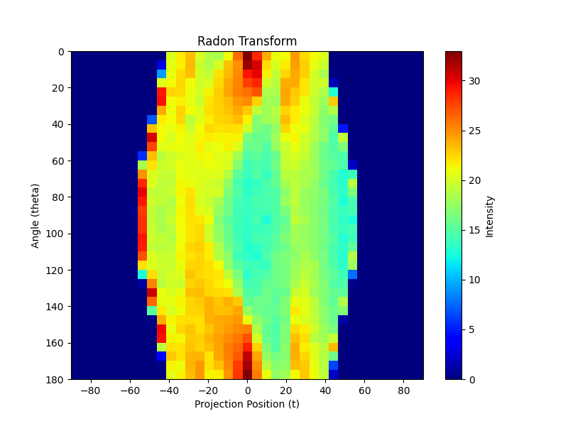
Q1b - Radon Transform

Slide 3
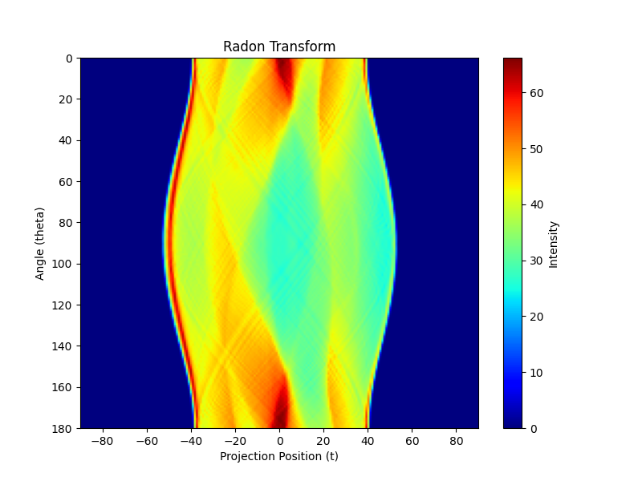
Q1c - Radon Transforms | s= 0.5

Slide 4
Q1 - Radon Transforms | s = 1

Slide 5
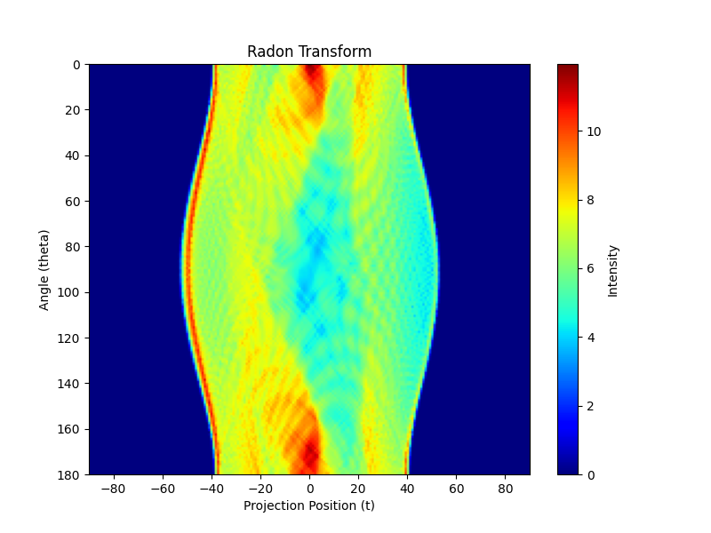
Q1 - Radon Transforms | s=3

Slide 6
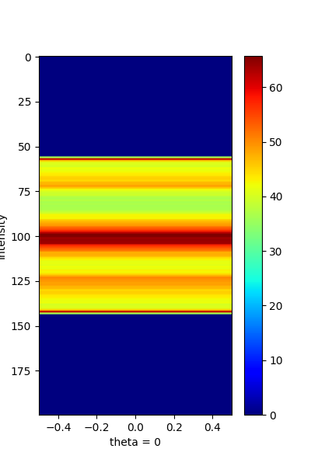
Q1 - 1D Plot Radon Transforms
s=0.5 , theta=0

Slide 7
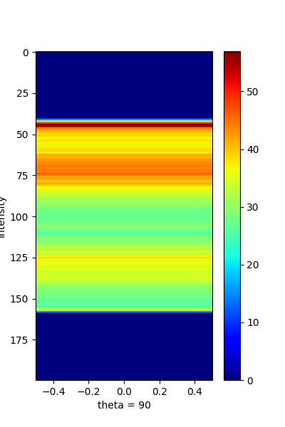
Q1 - 1D Plot Radon Transforms
s=0.5 , theta=90

Slide 8

Q1 - 1D Plot Radon Transforms
s=1 , theta=0

Slide 9
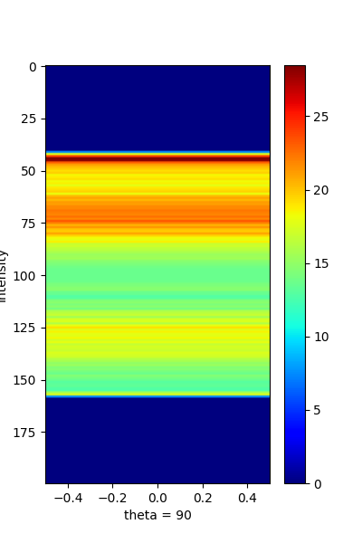
Q1 - 1D Plot Radon Transforms
s=1 , theta=90

Slide 10
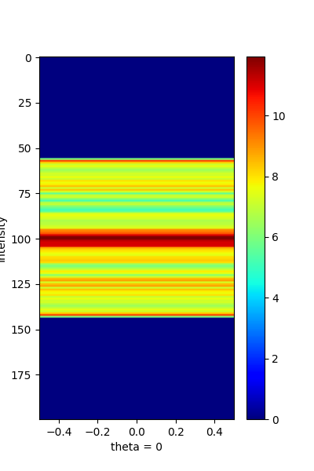
Q1 - 1D Plot Radon Transforms
s=3 , theta=0

Slide 11
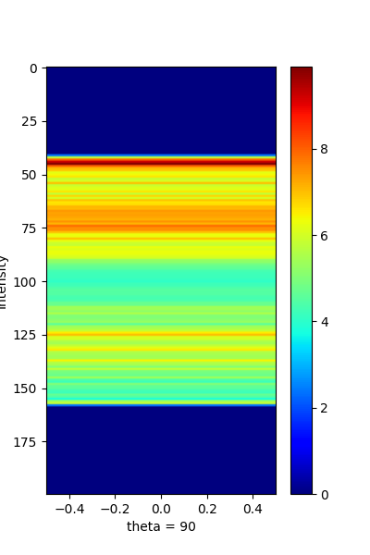
Q1 - 1D Plot Radon Transforms
s=3 , theta=90

Slide 12
Q1 - d
Too large delta t: May undersample the projection data, which can lead to missing finer details while reconstruction of images.
Too small delta t: Can help with catching finer details but with extremely small delta_t may cause increase in noise.
Too large delta_theta: With very large delta_theta, certain angular components may be missed during reconstruction of images.
Too small delta_theta: Will cause increase in scan times, reconstruction will be expensive(compute) and this will also lead to high does of radiation.

Slide 13
Q1 - e
Smaller pixel size would yield better detail at the cost of increased computation.
For delta s >> 1 pixel width : There would be few sampled points due to the large step size. It would lead to loss of fine details during the reconstruction process . This would be a good choice when computation is restriction.
For delta s << 1 : With more sample points there would be an improved reconstruction. But it would increase memory usage and computational cost.

Slide 14
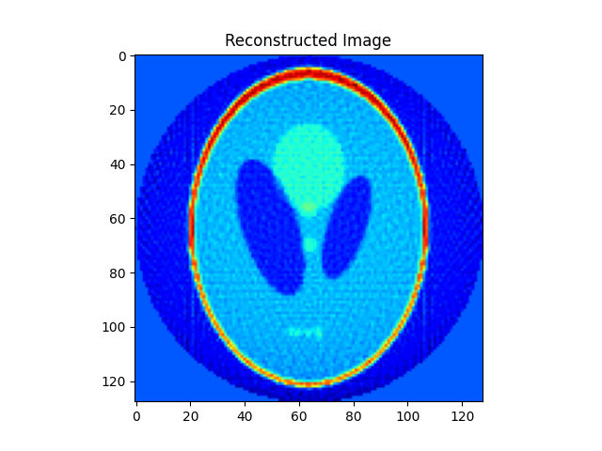
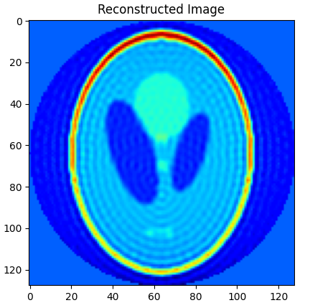
Q2a. Ram-Lak (L = Wmax, L = Wmax / 2)

Slide 15
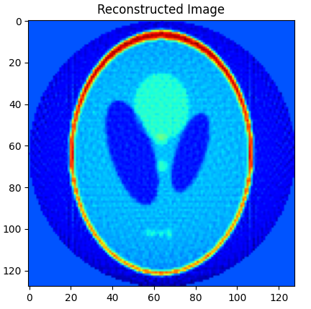

Q2a. Shepp-Logan (L = Wmax, L = Wmax / 2)

Slide 16

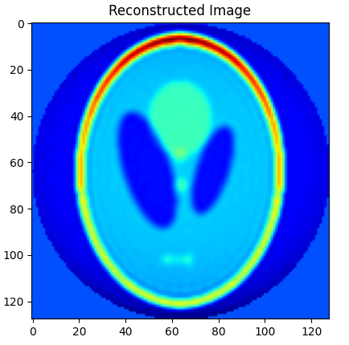
Q2a. Cosine (L = Wmax, L = Wmax / 2)

Slide 17
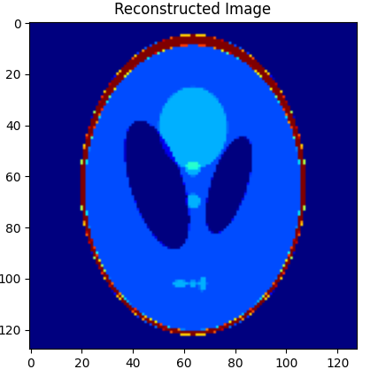
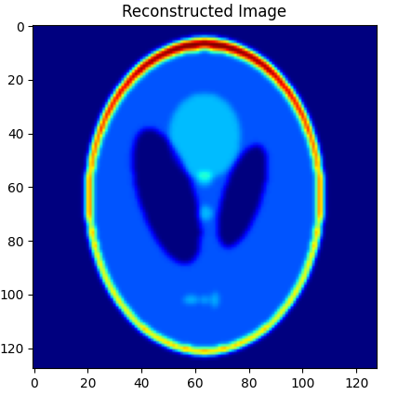
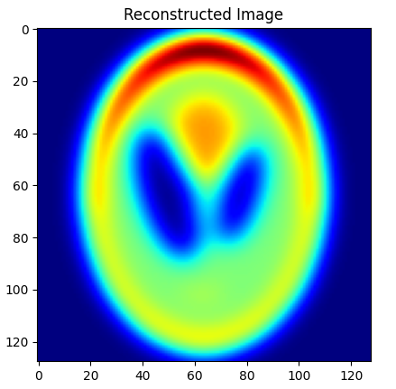
Q2b. Blurred Images(S0[Unblurred], S1, S5)

Slide 18
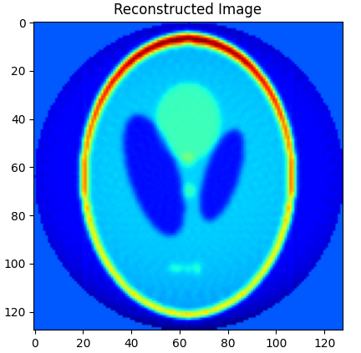
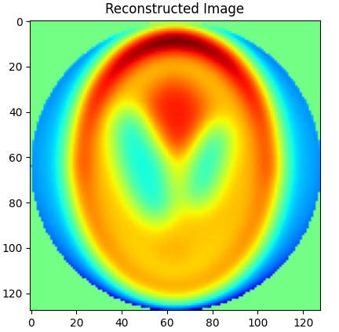
Q2b.Reconstructed Blurred Images(R0, R1, R5)

Slide 19
Q2b. RRMSE Values(R0, R1, R5)
RRMSE for phantom : 0.6598
RRMSE for blurred_1 : 0.6594
RRMSE for blurred_5 : 0.7382

Slide 20
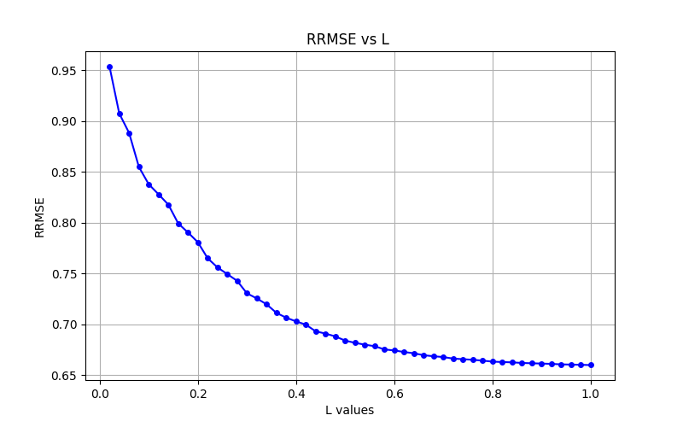
Q2c. RRMSE values as a function of L: R0

Slide 21
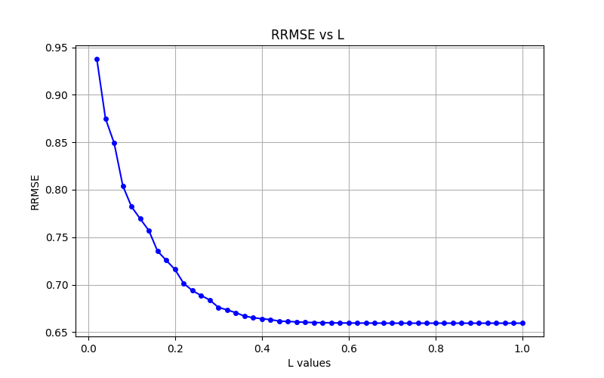
Q2c. RRMSE values as a function of L: R1

Slide 22
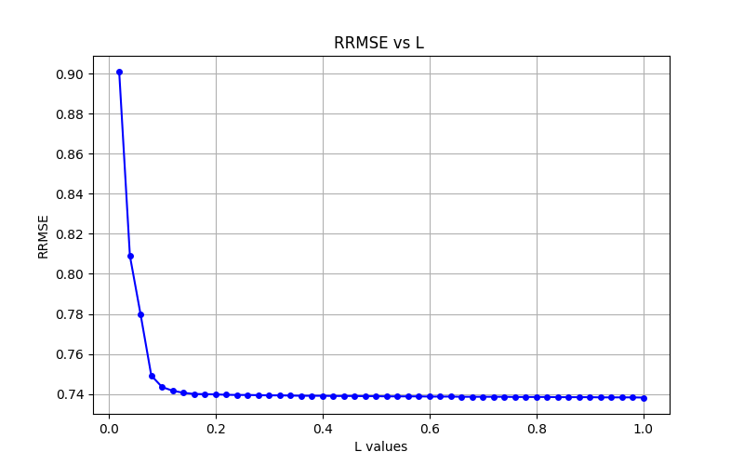
Q2c. RRMSE values as a function of L: R5

Slide 23
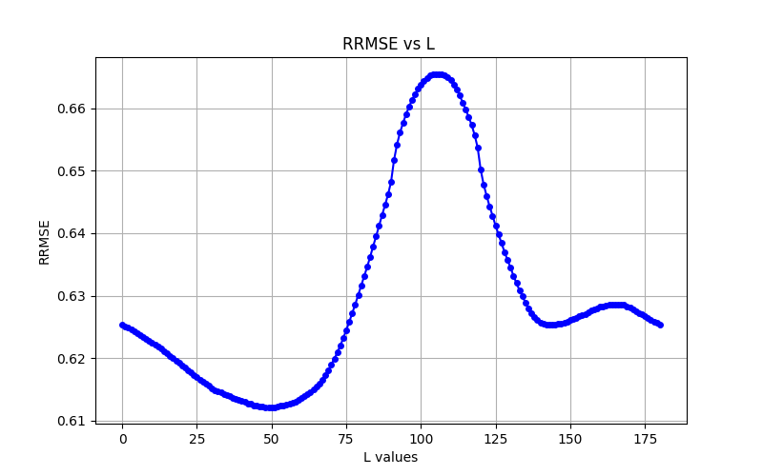
Q3a - RRMSE chest CT

Slide 24
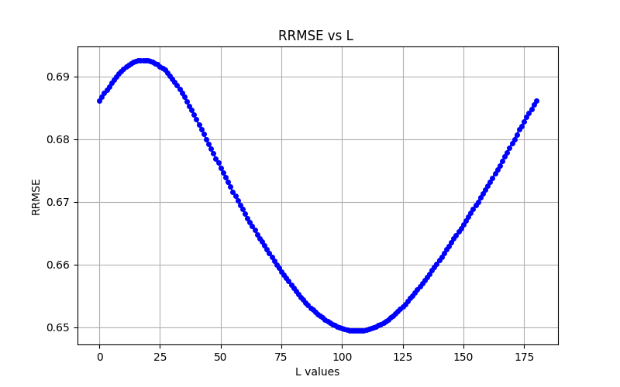
Q3a - RRMSE Phantom

Slide 25
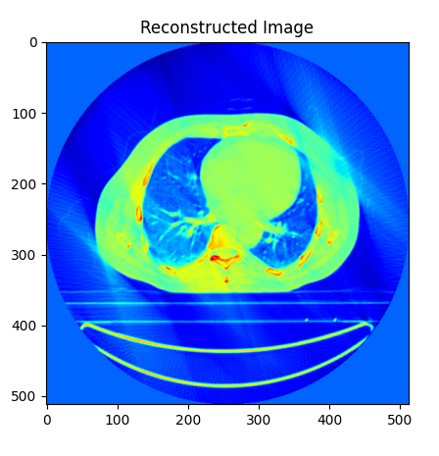
Q3b - Reconstructed chest CT
theta = 48, RRMSE = 0.6122

Slide 26
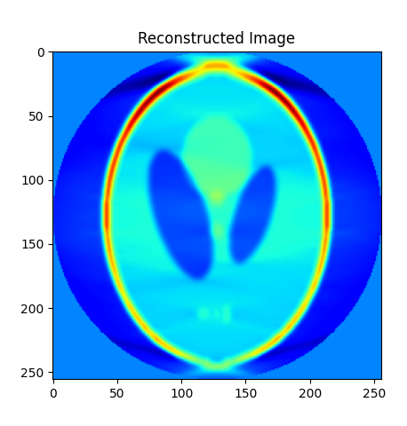
Q3b - Reconstructed Phantom
theta = 105, RRMSE = 0.6494

Slide 27
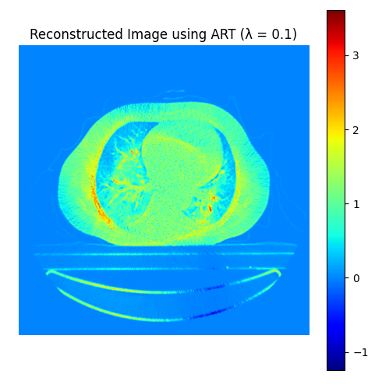
Q4 Reconstructed Image

Slide 28
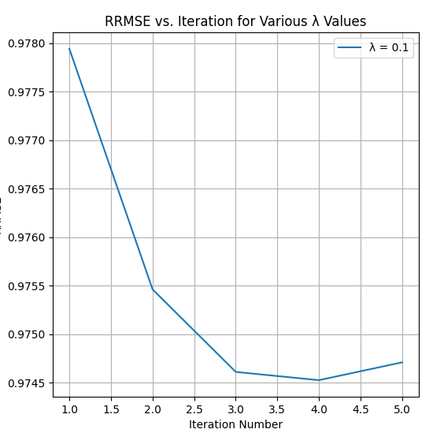
Q4: RRMSE vs Iterations

Slide 29
Thank You

